Slide 1
PARCH AND POSEY PAPER COMPANY
Data analytics approach

Slide 2
Agenda
Introduction
The Analytics team
Data Exploration And Insights
Model Development
Interpretation

Slide 3
Introduction
Project Recap
Problem Outline
Parch and Posey is a fictional paper-selling company based in the United State
The company sells three types of paper namely ‘Standard Paper’, “Gloss paper’ and ‘Poster Paper’
The steps carried out in this project include
-- Extraction of relevant data from Parch and Posey database
--Analysis of the data extracted using MS Excel tool
--Development of model that can help market campaigns and increase the company’s ROI
The Company will like to have an insight into how far they have come along since it’s launch
The company also want to understand ways to increase their ROI and marketing strategies.

Slide 4



Sakiru Habibat Omotola
Alerah Happines Nnendah
Omachi Grace
Ogunola Hiqmat Omotayo
Essien Grace Mighty
Chukwu Grace Chioma
Grace Bright Gracious
Onyedibe Harriet
Ikahyere Hannah
Hameedat Opeyemi
The Analytics team

Slide 5







Data Overview
Data Exploration and Insight
The total sales made between 2013 and 2017 is $23,141,512
The total sales on standard paper in the four years is $9,672,347
The total sales on gloss paper is $7,593,160
For Poster paper the total sales for the four years is $5,876,006
There are 351 customer accounts
And 50 sales reps all through the company’s locations
The company is located in 4 region namely West, Southeast, Midwest and Northeast
Total Sales
$23,141,512
Total Sales on Standard Paper
$9,672,347
Total Sales on Gloss Paper
$7,593,160
Total Sales on Poster Paper
$5,876,006
Total No of Accounts
351
Number of Sales Reps
50

Slide 6
Revenue By Year
Data Exploration and Insight
The data shows increase in revenue from the year 2014 to 2015
The year 2016 shows the peak in revenue for the three paper types
From this data it can also be deduced that Standard paper generates the highest revenue of the 3 paper types
Poster paper generates the least revenue of the 3 and Gloss paper brings more sales than poster paper

Slide 7
Revenue by Months & Years
Data Exploration and Insight
The data shows a surge in the sales of the 3 paper type from 2014 to 2016
The year 2017 and 2013 shows the lowest sales for the three paper types this is due to the fact that:
The company was launched in Dec. 2013 only few sales was made.
2017 sales is also low and its shows a sharp decline in the sales of the 3 paper for the last data entry in Jan. 2017

Slide 8
Top 10 Accounts By Patronage
Data Exploration
The Data shows EOG Resources as the leading account in the patronage of the 3 paper types
These accounts contain mostly the Platinum and Gold customers
The chart also shows the 10 leading accounts in terms of paper patronage

Slide 9
Top 10 Accounts by the quantity of paper ordered
Data Exploration
Apart from Mosaic account, it can be observed that majority of the top 10 accounts order for gloss paper
Leucadia National is a leading account in terms of Counts of ordered
General Dynamics ordered Gloss paper the most
Mosaic account ordered poster and Standard paper the most

Slide 10
Revenue By Region
Data Exploration
The data shows that there are 4 regions
Midwest, West, Southeast and Northeast
Northeast generate the highest revenue of the four region
The Midwest generate the least revenue of the four

Slide 11
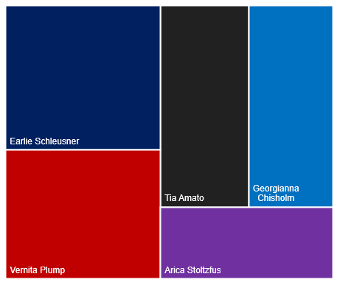
Sales Reps Performance
Data Exploration
Top 5 Sales Rep Performance Based on NO. of orders
There are 50 sales representatives in the 4 regions
The charts shows the top 5 sales reps based on the:
---number of orders they attended to
--- number of customers
---total revenue they generated
Earlie Schleusner is a leading sales rep followed by Vernita Plump
Arica Stoltzfus is the last sales rep of the 5 sales reps

Slide 12
Channels for Web Events
Data Exploration
There are a total of 6 channels used for web events
The channels used the most is Direct
Twitter and Banners are used the least

Slide 13
Customer Classification – Targeting High Value Customers
Model Development
Based on the Data analysis and visuals made. Customer classification was done using the average revenue generated from all the accounts
The four segments are shown in the charts with the counts of Silver account the highest of the four
This classification will help Parch and Posey Marketing Team target high value customers to increase the company’s ROI

Slide 14
Customer Classification – Targeting High Value Customers by Region
Model Development
The chart shows that Northwest has the highest number of Gold and platinum accounts
Southwest has the highest number of silver accounts
Northwest and west has the same amount of platinum accounts

Slide 15
Interpretation
Data driven decision that must be made from this analysis include
A good marketing strategies must be put in place to target more Platinum and Gold customer in the Northeast and in the West Region
These are some of the accounts that will come up as one of the most valuable customers to the company, they are all Platinum accounts.
To increase revenue Southeast and Midwest regions must be strategically worked on by the marketing Team to meet up with the two other leading regions
Company Name | Company Region | Customer Segment
EOG Resources | West | Very High Value Customer
Mosaic | West | Very High Value Customer
IBM | Northeast | Very High Value Customer
General Dynamics | Northeast | Very High Value Customer
Republic Services | West | Very High Value Customer

Slide 16
Thank You

